Slide 1

Making this resource work for you
Prior to teaching this lesson, please refer to the ‘Unit Overview and Planning Document’.
Further guidance on planning Science Mastery lessons can be found in the detailed planning guidance document.
Refer to the ‘notes’ section on each slide for useful information, including suggested expositions, pedagogical content knowledge, suggested questions, answers and more. Consider using presenter mode so you can see this guidance throughout the lesson.
The introduction slides can be adapted to suit your teaching style and the needs of your class.
Before the lesson, adapt the fix-it slide to address any misconceptions identified in the previous lesson’s exit ticket.
Choose from the suggested activities to suit your class. The intention is not that you complete all of these, but that you select those which ones are most appropriate for your students. It may be appropriate to further adapt activities for your students.
These lessons are designed to occupy approximately 1 hour. To adapt for a shorter or longer lesson duration we advise you to adapt the activity section accordingly.
Please consider using the final slide to send feedback about this lesson or examples of PowerPoints that you have adapted to our design team. Your feedback is used to improve Science Mastery for all of our teachers and students. We appreciate all suggestions and comments.
Thank you for reading!
The Science Mastery Team

Slide 2
Introducing Concentration Match each term with its description
Term | Description
A. A saturated solution | 1. Made of one type of atom or compound
B. Dissolves | 2. When the solute particles fill in the spaces between the solvent particles
C. A pure substance | 3. The substance that dissolves in a solvent.
D. Solute | 4. A solution in which no more solute will dissolve
E. Insoluble | 5. A substance that will not dissolve to form a solution
A=
B=
C=
D=
E=
4
2
1
3
5
Notes:
This ‘Do Now’ activity interleaves learning from C1.3 – mixtures (Year 7).
Answers:
A = 4
B = 2
C = 1
D = 3
E = 5

Slide 3
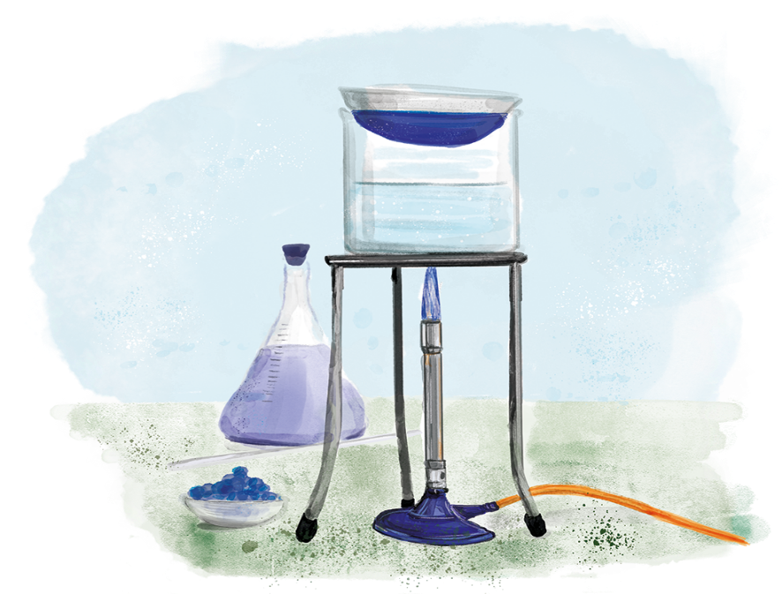

C3.2.7
11/02/2025
Introducing Concentration
C3.2.1 Prior Knowledge Review
C3.2.2 Relative Formula Mass
C3.2.3 Percentage by Mass
C3.2.4 Conservation of Mass
C3.2.5 Balancing Equations
C3.2.6 Uncertainty
C3.2.7 Introducing Concentration
C3.2.8 Concentration Calculations
C3.2.9 Soluble Salts
C3.2.10 Making Soluble Salts
C3.2.11 Making Soluble Salts 2
Notes:
Big idea: Reactions Rearrange Matter
By this point, students should be comfortable with determining if an equation is balanced, based on their knowledge and application of conservation of mass, subscripts and coefficients. In this lesson, students will link back to their previous study of mixtures in year 7, thinking about the concentration of solutions.
Suggested hook: Ask students what the difference is between a glass of concentrated orange squash and a dilute one. For effect, have both at the front of the room. Challenge students to use scientific terminology from the Do Now in their answer: mixture, solvent, insoluble, soluble, etc.

Slide 4

Following this lesson, students will be able to:
Convert units of volume between dm³ and cm³
Describe what is meant by concentration
Recall the unit of concentration
Key Words:
solute
solvent
mass
concentration
volume

Slide 5
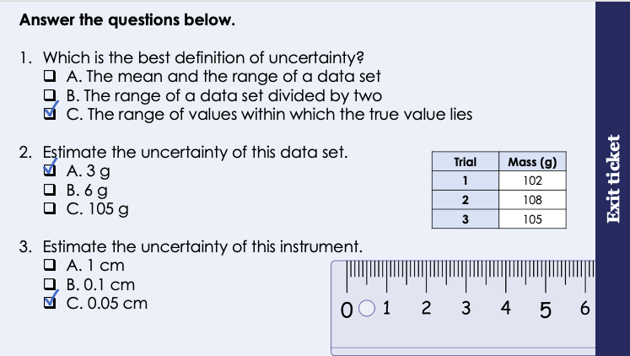
This is the fix-it portion of the lesson
The fix-it is an opportunity to respond to gaps in knowledge, especially those identified by the previous lesson’s exit ticket.
The teacher should customise this slide as needed, to facilitate
reteach, explanation, demonstration or modelling of ideas and concepts that students have not yet grasped or have misunderstood.
practise answering specific questions or of key skills.
redrafting or improving previous work.
Notes:
Purpose: to spend time on any gaps identified in previous learning from exit ticket feedback.
Suggested guidance from previous lesson’s exit ticket:
Q1. Answer: C
If students answer A, they have understood that the mean and range are both measurements that can be taken from a data set but have not understood what the idea of uncertainty actually means. If students answer B, they have identified how to estimate it from repeated measurements rather than the definition. To fix-it, reteach the idea of uncertainty within a data set and how to estimate it.
Q2. Answer: A
If students answer B, they have forgotten to divide the range by two. If students answer C they have calculated the mean rather than the uncertainty. To fix-it, give students more practice of estimating the mean from repeated measurements.
Q3. Answer: C
If students answer A, they are not clear on the meaning of the smallest interval, and have only used the numbered intervals. To fix-it, get pupils to practice identifying the intervals on different instruments. If students answer B, they have identified the smallest interval but have not divided by two. To fix-it, get pupils to practice estimating the uncertainty from different instruments.

Slide 6
Which is more concentrated?
Purple juice is added to two glasses of water.
The concentration of a solution tells you how much solute is dissolved in a given volume of a solution.
Notes:
These slides are a review from C3.2.
Exposition type: Explanation
This activity introduces concentration in a qualitative way, before bringing in the quantitative.
It is worth demonstrating the dilution of squash to show a dilution series, or to ask questions about what is happening to the mass of solute per unit volume as the dilution occurs. Be very clear regarding the meaning of the term ‘amount’ as students have now met amount of substance meaning moles. At this stage focus on mass in g.
Suggested exposition:
A solution is composed of a solute and a solvent.
• A solvent is the substance a solute dissolves in
• A solute is the substance that dissolves in a solvent.
• A saturated solution is a solution in which no more solute will dissolve
• An unsaturated solution is a solution in which solute will dissolve
• A substance is soluble if it will dissolve to form a solution
• A substance is insoluble if it will not dissolve to form a solution
• A solute dissolves when the solute particles fill in the spaces between the solvent particles
The concentration of a solution tells you how much solute is dissolved in a given volume of a solution.
The PhET animation can be used at any point in the introduction, suggested with slide 10. The link is: https://edu.rsc.org/download?ac=501331 or https://phet.colorado.edu/en/simulation/concentration
Image source
https://world.openfoodfacts.org/product/9300673000484/blackcurrant-juice-syrup-ribena (creative commons)
https://world.openfoodfacts.org/product/5054267006102/ribena-blackcurrant (creative commons)

Slide 7
Volume
Volume is the amount of space that a substance or object takes up.
How many units of volume can you think of?
m³ (cubic metres)
cm³ (cubic centimetres)
L (Litres)
mL (millilitres)
Scientists use a different unit of volume: dm³ (cubic decimetres)
1 dm³ = 1 L = 1000 cm³
Notes:
Suggested script:
What do we mean by volume? Volume is the amount of space that something takes up.
Look at those two chairs – they take up the same amount of space, so we can say that they have the same volume.
Look at this beaker of water, we can read from the side the the volume of the liquid here is 250 cm³. Now if I pour this liquid into another container, say this graduated cylinder, has the volume changed? No. The shape that this liquid takes up has changed, but the volume has not changed. If I poured this liquid all over the floor it would still have a volume of 250 cm³.
What are the units of volume? We’ve already mentioned one – cm³. What are the others?
Reveal the answers on the board once studens have had time to list theirs and offer some answers.
Cubic metres can also be said as metres cubed, cubic centimetres as centimetres cubed. You should know from maths that volume = length x breadth x height, which is why the units are cubic rather than squared.
We also have litres – this is the volume we often buy milk in! and millilitres.
Scientists use decimetres cubed as the unit of volume, and we write it like this, with a small ‘3’.
1 dm³ is equal to 1 L. And that volume is the same as 1000 cm³. These are just different ways of writing the same volume. It’s like saying 1 metre is the same as 100 cm

Slide 8
Converting between units of volume
÷ 1000
To change cm³ to dm³ you divide by 1000 (÷ 1000)
1 dm³ = 1 L = 1000 cm³
x 1000
To change dm³ to cm³ you multiply by 1000 (x 1000)
Let's practice converting these volumes to different units.
1000 cm³ = _______ dm³
5000 cm³ = _______ dm³
2403 cm³ = _______ dm³
145 cm³ = _______ dm³
1
1000
1 dm³ = _______ cm³
10 dm³ = _______ cm³
179 dm³ = _______ cm³
0.2 dm³ = _______ cm³
5
10000
2.403
179000
0.145
200
Notes:
Suggested script:
Sometimes when you are given a number in one unit, you will have to figure out what that number is in another unit. We call this unit conversion.
You’ve done this lots of times before, for example, if I asked you what 200 cm is in m, you would say….2 m. You have converted the unit from cm to m.
What is 1 minute in seconds? 60 seconds. There again you converted a unit. You can do that because you know that in one minute there is 60 seconds, so in two minutes there must be 120 seconds, etc.
Now lets do the same thing but with units of volume.
Like we said before, 1 dm³ = 1 L = 1000 cm³
Because 1 dm³ = 1 L, you do not need to convert the numbers. If you are given a volume in L, it will be the same in dm³. 27 L = 27 dm³.
Now because 1 dm³ = 1000 cm³, to change a number in dm³ to cm³ you need to multiply it by 1000. so 2 dm³ = 2000 cm³. And to go back the other way, from cm³ to dm³ you have to divide by 1000, so 20,000 cm³ is the same as 20 dm³.
Why do we have two different ways of saying the same thing? The units are useful in different scenarios. Seconds is more useful when timing short events precisely. Minutes are more suited to less precise measurements, like the length of an assessment or a lesson. Hours, days, weeks, months, years all are useful for different things. The same applies to most other things that we measure. Volume can be measured in lots of different units.

Slide 9
What is concentration?
Concentration simulation
Notes:
Purpose: to introduce new learning.
PhET link:
https://phet.colorado.edu/en/simulation/concentration (there are links here to embed the animation into your slide or it can be played directly from the website).
Use this animation to demonstrate what happens to the concentration of a solution as the amount of solute increases – avoid using the meter at this stage as it measures the solution in mol/L (it is an American animation).

Slide 10
Concentration
g
dm³
Concentration is the mass of a solute in a certain volume of solvent.
So, the unit of concentration is g/dm³
High concentration
Low concentration
Notes:
Suggested script:
So we can define concentration is the mass of a solute in a certain volume of solvent. Think about it, if you have a bigger mass of solute (like salt) in a certain volume of solvent (like water), then you will have a higher concentration of solution.
We measure mass in grams, and volume in dm³, so the unit of concentration is g/dm³.
Display the diagrams.
You can increase the concentration of a solution by adding more solute or less solvent. You can decrease the concentration by adding more solvent or less solute. Demonstrate this concept using the squash from earlier in the lesson.
Teacher note:
In KS4, students will study moles. At this point they will be introduced to another unit of concentration: mol/dm³. Until that point, we will use g/dm³ for concentration calculations.
g/dm³ can also be written as g dm⁻³ . For now, we will only use the former to avoid confusion, but be aware that some other textbooks and resources might use the latter.

Slide 11
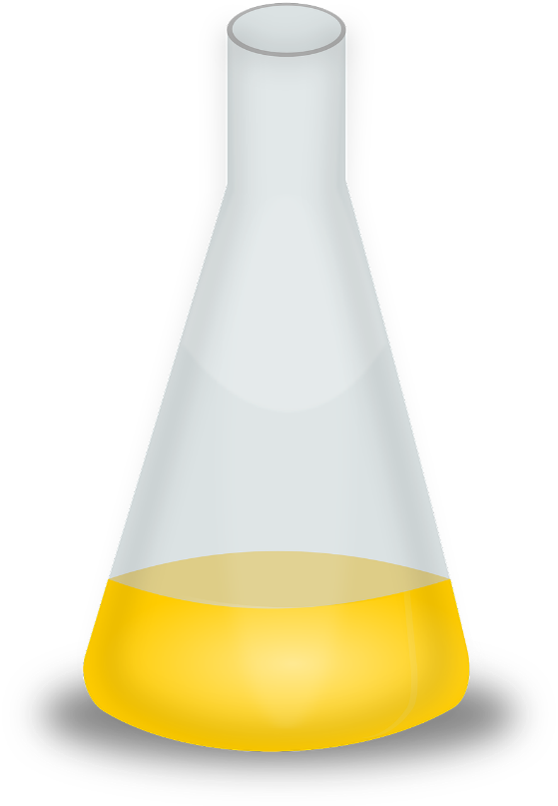
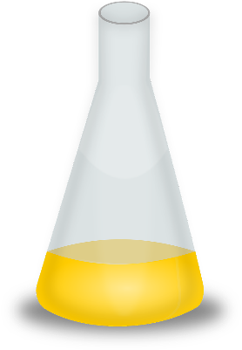


Which flask contains the most concentrated solution?
= solute particle
= solvent particle
Notes:
Answer: A
Note: Each magnifying glass is observing the same volume of liquid.
Image source: Pixabay

Slide 12




Sugar is added to hot water and stirred. After a while it can’t be seen anymore. Choose the correct statements below.
The sugar joins with the water to make a new liquid.
The sugar melts.
The sugar breaks up into smaller pieces and mixes with the water.
The sugar disappears.
Notes:
The only correct statement here is ‘The sugar breaks up into smaller pieces and mixes with the water’. The other statements all represent common misconceptions.
Suggested guidance:
Talk tasks can be used in a variety of ways to suit the particular needs of the students you are teaching. Through exchanging views with others, students develop their understanding of the science beyond what could be achieved individually.
Science classrooms that successfully integrate talk have the following features:
Science talk is a regular feature of lessons and is woven into classroom activities.
Students are paired or grouped strategically by the teacher to ensure productive interaction. This might take into consideration the students’ proficiency of the English language, how encouraging they might be to peers and their attainment in the topic. It’s a good idea to consider these pairings in the class seating plan.
Students are encouraged and supported to talk, but are not forced to talk.
The teacher should take on the role of a facilitator, engaging with conversations where necessary and encouraging or steering the conversation where needed.
Students are encouraged to use the language they have to express their ideas (e.g., everyday language, imperfect English, native language), but also to incorporate science specific terminology where this is more accurate or has been taught.
6. Scientifically inaccurate ideas are not dismissed by the partner or teacher; open discussion and further investigation are relied on to help students construct ideas that support them to progress in their scientific understanding.
7. Guidelines for behaviour during talk tasks are explicit and frequently reviewed. Rules for students might be:
Listen carefully to your partner
Take turns talking.
Speak one at a time, without interrupting.
Politely agree or disagree and explain why.
Politely point out if your partner has used a scientific word incorrectly, if they have explained the science incorrectly, or if there is a more accurate way to describe something.
If confused, ask questions.
Stay focused on the discussion topic.
Respond to one another.

Slide 13
Drill
You have salt, water and salty water. Which is the solute?
You have salt, water and salty water. Which is the solvent?
You have salt, water and salty water. Which is the solution?
What is 1 dm³?
What is 25 cm³ in dm³?
What is 0.253 dm³ in cm³?
Define concentration
How can you decrease concentration?
Draw a particle diagram to show low concentration.
Notes:
Purpose: This is a knowledge drill. The purpose of this is to check that the critical knowledge is secure before pupils move onto independent practice.
Suggested guidance: There are a range of ways this could be done depending on time and ability range of the class:
Mini whiteboards
As full sentences in exercise books
As short answers in exercise books
In the pupil workbook
As pair talk
As cold call

Slide 14
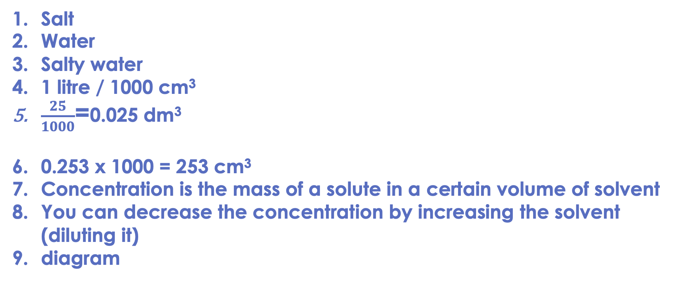
Drill answers
Salt
Water
Salty water
1 litre / 1000 cm³
$\frac{25}{1000}$=0.025 dm³
0.253 x 1000 = 253 cm³
Concentration is the mass of a solute in a certain volume of solvent
You can decrease the concentration by increasing the solvent (diluting it)
diagram
Notes:
Purpose: This is a knowledge drill. The purpose of this is to check that the critical knowledge is secure before pupils move onto independent practice.
Suggested guidance: There are a range of ways this could be done depending on time and ability range of the class:
Mini whiteboards
As full sentences in exercise books
As short answers in exercise books
In the pupil workbook
As pair talk
As cold call

Slide 15
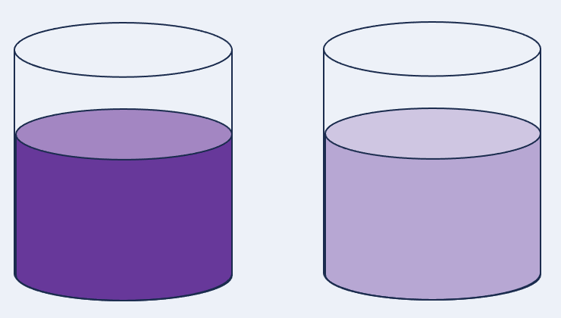

I: Concentration
Example question:
Describe the difference in concentrations in this image.
To ‘describe’, your answer should:
Use bullet points.
Include each step of the process in a logical order.
Use keywords throughout the answer
Stay focused on the question.
Model answer:
The beaker on the left is more concentrated as it is darker in colour.
The beaker on the right is lighter in colour, as it has had water added to it, so it is more dilute.
So, the concentration of the lighter colour is lower than the darker coloured liquid.
Notes:
This slide models the process of answering a describe question.
Firstly, students are presented with a generic describe question, along with a model answer. Students are also given some simple guidance to follow for producing their own describe answer.
The generic question and answer should be used by the teacher to remind students of
the key features of a great answer
how to structure their answer
why the model answer is a good example
Following this, students will be required to apply this process to answer their own describe question, which will appear in place of the generic questions. This describe question will be specific to the topic students are learning about in the lesson. Give students time to write their own answer to this, ensuring that they use the guidance provided. To further scaffold this task for students, it may be appropriate to:
pair students up to write an answer together
list for students the key words you would like them to include in the answer
provide a writing frame or ‘points to include’ for students
A model answer for this question will appear. Teachers should review the model answer with students by referencing the guidance in the green box. For example ‘we can see item 1 in the guidance is to use bullet points to keep your answer clear. Notice in the model answer here we have done just that’. Or ‘item 2 in the guidance here says that we should use scientific keywords in the answer. Has this been achieved in the model answer? Where can we see this?’.

Slide 16
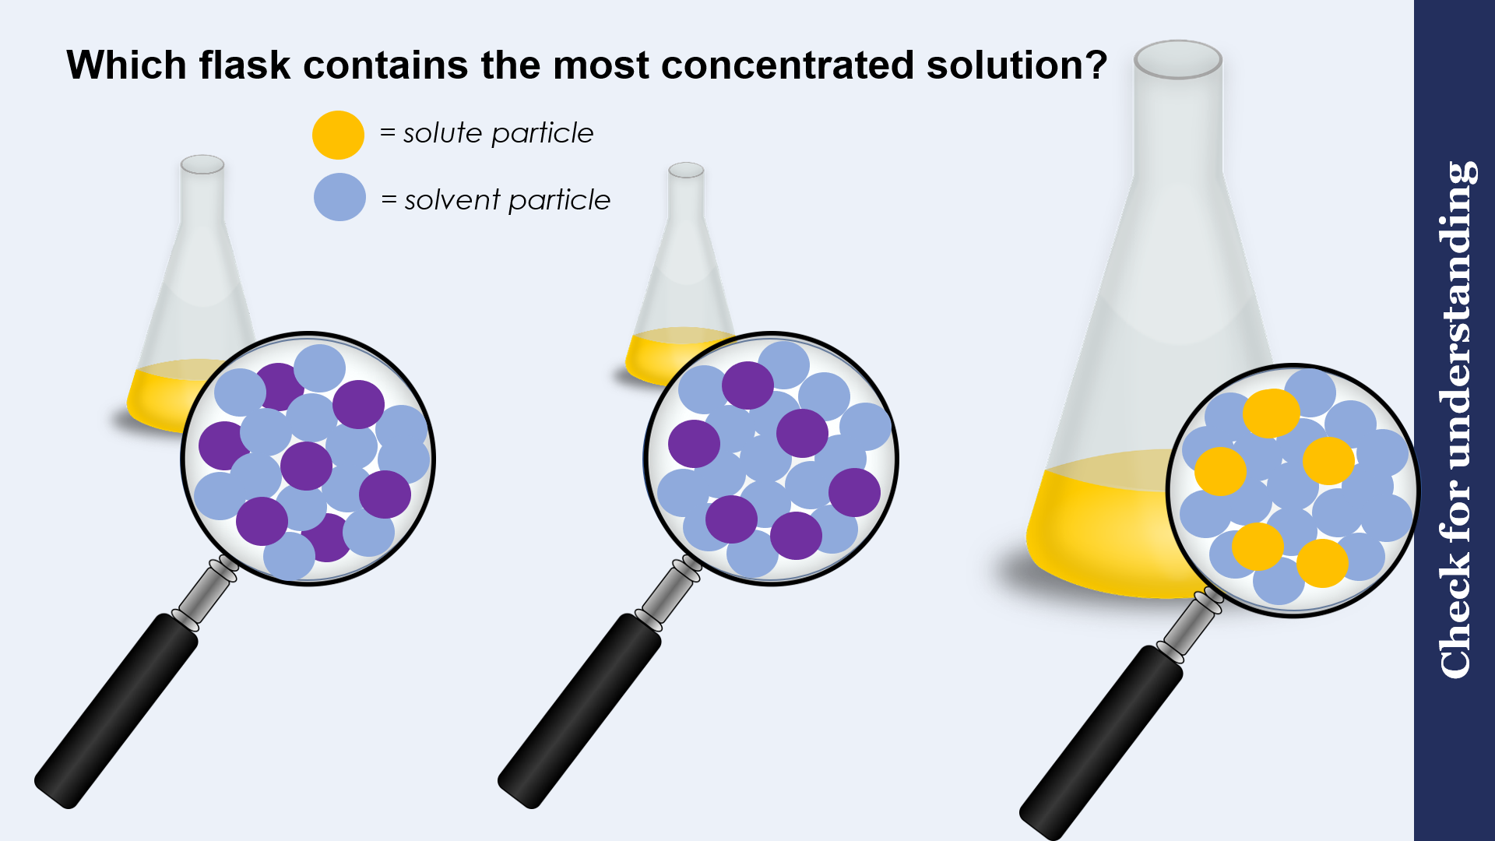
We: Concentration
Example question:
To ‘explain’ your answer should:
Begin with a scientific statement.
Use ‘this means that’, ‘because’ or ‘so’ to link your statement to the question.
Explain the difference in concentrations in this
image using particle
diagrams.
Model answer:
The beaker on the left is more concentrated as it has many more particles of solute in the same volume as the one in the glass. (First diagram)
The beaker on the right has had water added to it so it is more dilute. You can see that its lighter in colour. This means its concentration is less than the one in the bottle. So, there are less particles in the same volume (second diagram
Notes:
This slide models the process of answering an explain question.
Firstly, students are presented with a generic explain question, along with a model answer. Students are also given some simple guidance to follow for producing their own describe answer.
The generic question and answer should be used by the teacher to remind students of
the key features of a great answer
how to structure their answer
why the model answer is a good example
Following this, students will be required to apply this process to answer their own explain question, which will appear in place of the generic questions. This explain question will be specific to the topic students are learning about in the lesson. Give students time to write their own answer to this, ensuring that they use the guidance provided. To further scaffold this task for students, it may be appropriate to:
pair students up to write an answer together
list for students the key words you would like them to include in the answer
provide a writing frame or ‘points to include’ for students
A model answer for this question will appear. Teachers should review the model answer with students by referencing the guidance in the green box. For example ‘we can see item 1 in the guidance is to begin with a scientific statement. Notice in the model answer here we have done just that’. Or ‘item 2 in the guidance here says that we should use a linking statement in the answer. Has this been achieved in the model answer? Where can we see this?’.

Slide 17
You: Concentration
= solute particle
Example question:
Explain which of these samples has a higher concentration. Both samples have the same volume.
= solvent particle
Model answer:
A has a higher concentration
Because there are more solute particles in the same volume
A
B

Slide 18
Complete the unit conversion worksheet
seconds | minutes | hours
3600 | 60 | 1
60 | 1 | 0.16
18000 | 300 | 5
2600 | 43.3 | 0.72
18000 | 300 | 5
32400 | 540 | 9
30 | 0.5 | 0.0008
g | kg
1000 | 1
5000 | 5
15000 | 15
11000 | 11
500 | 0.5
50 | 0.05
5 | 0.005
cm³ | dm³ | L
1000 | 1 | 1
6000 | 6 | 6
5000 | 5 | 5
500 | 0.5 | 0.5
30 | 0.03 | 0.03
500 | 0.5 | 0.5
50 | 0.05 | 0.05

Slide 19
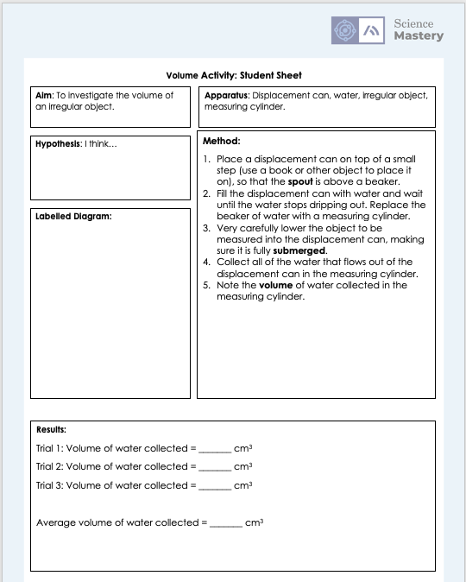
Volume Practical
In this practical activity, you will
calculate the volume of an irregularly shaped object,
practice calculating the volume of shapes
convert between units of volume

Slide 20
Answer the questions below.
Salt dissolves in water. Which word describes salt best?
A. soluble
B. insoluble
C. solvent
5 g of solute is dissolved in 200cm³ of solution. Which of these quantities has the same volume as this solution?
A. 0.2 dm³
B. 200000 cm³
C. 0.005 kg
Select the answer below which is equal to 0.05 dm³.
A. 500 cm³
B. 50 cm³
C. 0.00005 cm³
✓
✓
✓
Notes:
Q1. Answer: A
If students answer B or C, it suggests that they are mixing up key terms related to solubility. To fix-it, demonstrate the dissolving of salt in water, narrating as you go using the key terms in the ‘DO Now’ slide of this lesson. Use resources from unit C1.3 to reteach if necessary. Ask students to match the key terms with their definitions, or to assign key terms to the salt, water and salt water.
Q2. Answer: A
If students answer B, it suggests they have multiplied by 1000 instead of dividing by 1000 to convert cm³ to dm³. To fix-it, reteach how to convert from one unit to another, using slide 7 to help. Give students some unit conversions to practice. If students answer C, it suggests that they have confused volume with mass. To fix-it, reteach the definition of volume, with examples. Compare with mass, and show examples of masses in g and kg.
Q3. Answer: B
If students answer A, it suggests they have multiplied by 10000 instead of 1000. To fix-it, give the student some more unit conversions to practise. Use slide 7 to reteach the method for converting from one unit to another.
If students answer C, it suggests they have divided by 1000 instead of multiplying by 1000 to convert dm³ to cm³. To fix-it, reteach how to convert from one unit to another, using slide 7 to help. Give students some unit conversions to practice.

Slide 21
Lesson C3.2.7
What was good about this lesson? | What can we do to improve this lesson?
Send us your feedback by clicking this link
or by emailing sciencemastery@arkonline.org
Thank you!

